Slide 1
ETL Process in Data Warehouse
Dibya Tara Shakya

Slide 2
Outline
ETL
Extraction
Transformation
Loading

Slide 3
ETL Overview
Extraction Transformation Loading – ETL
To get data out of the source and load it into the data warehouse – simply a process of copying data from one database to other
Data is extracted from an OLTP database, transformed to match the data warehouse schema and loaded into the data warehouse database
Many data warehouses also incorporate data from non-OLTP systems such as text files, legacy systems, and spreadsheets; such data also requires extraction, transformation, and loading
When defining ETL for a data warehouse, it is important to think of ETL as a process, not a physical implementation

Slide 4
ETL Overview
ETL is often a complex combination of process and technology that consumes a significant portion of the data warehouse development efforts and requires the skills of business analysts, database designers, and application developers
It is not a one time event as new data is added to the Data Warehouse periodically – monthly, daily, hourly
Because ETL is an integral, ongoing, and recurring part of a data warehouse
  Automated
  Well documented
  Easily changeable

Slide 5
ETL Staging Database
ETL operations should be performed on a relational database server separate from the source databases and the data warehouse database
Creates a logical and physical separation between the source systems and the data warehouse
Minimizes the impact of the intense periodic ETL activity on source and data warehouse databases

Slide 6
Extraction

Slide 7
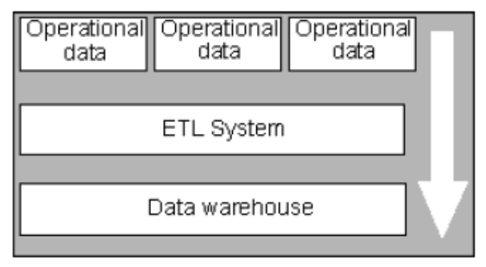
Extraction
The integration of all of the disparate systems across the enterprise is the real challenge to getting the data warehouse to a state where it is usable
Data is extracted from heterogeneous data sources
Each data source has its distinct set of characteristics that need to be managed and integrated into the ETL system in order to effectively extract data.

Slide 8
Extraction
ETL process needs to effectively integrate systems that have different:
  DBMS
  Operating Systems
  Hardware
  Communication protocols
Need to have a logical data map before the physical data can be transformed
The logical data map describes the relationship between the extreme starting points and the extreme ending points of your ETL system usually presented in a table or spreadsheet

Slide 9
Target |  |  | Source |  |  | Transformation
Table Name | Column Name | Data Type | Table Name | Column Name | Data Type
The content of the logical data mapping document has been proven to be the critical element required to efficiently plan ETL processes
The table type gives us our queue for the ordinal position of our data load processes—first dimensions, then facts.
The primary purpose of this document is to provide the ETL developer with a clear-cut blueprint of exactly what is expected from the ETL process. This table must depict, without question, the course of action involved in the transformation process
The transformation can contain anything from the absolute solution to nothing at all. Most often, the transformation can be expressed in SQL. The SQL may or may not be the complete statement

Slide 10
The analysis of the source system is usually broken into two major phases:
  The data discovery phase
  The anomaly detection phase

Slide 11
Extraction - Data Discovery Phase
Data Discovery Phase
key criterion for the success of the data warehouse is the cleanliness and cohesiveness of the data within it
Once you understand what the target needs to look like, you need to identify and examine the data sources

Slide 12
Data Discovery Phase
It is up to the ETL team to drill down further into the data requirements to determine each and every source system, table, and attribute required to load the data warehouse
  Collecting and Documenting Source Systems
  Keeping track of source systems
  Determining the System of Record - Point of originating of data
  Definition of the system-of-record is important because in most enterprises data is stored redundantly across many different systems.
  Enterprises do this to make nonintegrated systems share data. It is very common that the same piece of data is copied, moved, manipulated, transformed, altered, cleansed, or made corrupt throughout the enterprise, resulting in varying versions of the same data

Slide 13
Data Content Analysis - Extraction
Understanding the content of the data is crucial for determining the best approach for retrieval
- NULL values. An unhandled NULL value can destroy any ETL process. NULL values pose the biggest risk when they are in foreign key columns. Joining two or more tables based on a column that contains NULL values will cause data loss! Remember, in a relational database NULL is not equal to NULL. That is why those joins fail. Check for NULL values in every foreign key in the source database. When NULL values are present, you must outer join the tables
- Dates in nondate fields. Dates are very peculiar elements because they are the only logical elements that can come in various formats, literally containing different values and having the exact same meaning. Fortunately, most database systems support most of the various formats for display purposes but store them in a single standard format

Slide 14
During the initial load, capturing changes to data content in the source data is unimportant because you are most likely extracting the entire data source or a potion of it from a predetermined point in time.
Later the ability to capture data changes in the source system instantly becomes priority
The ETL team is responsible for capturing data-content changes during the incremental load.

Slide 15
Determining Changed Data
Audit Columns - Used by DB and updated by triggers
Audit columns are appended to the end of each table to store the date and time a record was added or modified
You must analyze and test each of the columns to ensure that it is a reliable source to indicate changed data. If you find any NULL values, you must to find an alternative approach for detecting change – example using outer joins

Slide 16
Determining Changed Data
Process of Elimination
Process of elimination preserves exactly one copy of each previous extraction in the staging area for future use.
During the next run, the process takes the entire source table(s) into the staging area and makes a comparison against the retained data from the last process.
Only differences (deltas) are sent to the data warehouse.
Not the most efficient technique, but most reliable for capturing changed data

Slide 17
Determining Changed Data
Initial and Incremental Loads
Create two tables: previous load and current load.
The initial process bulk loads into the current load table. Since change detection is irrelevant during the initial load, the data continues on to be transformed and loaded into the ultimate target fact table.
When the process is complete, it drops the previous load table, renames the current load table to previous load, and creates an empty current load table. Since none of these tasks involve database logging, they are very fast!
The next time the load process is run, the current load table is populated.
Select the current load table MINUS the previous load table. Transform and load the result set into the data warehouse.

Slide 18
Transformation

Slide 19
Transformation
Main step where the ETL adds value
Actually changes data and provides guidance whether data can be used for its intended purposes
Performed in staging area

Slide 20
Transformation
Data Quality paradigm
Correct
Unambiguous
Consistent
Complete
Data quality checks are run at 2 places - after extraction and after cleaning and confirming additional check are run at this point

Slide 21
Transformation - Cleaning Data
Anomaly Detection
  Data sampling – count(*) of the rows for a department column
Column Property Enforcement
  Null Values in reqd columns
  Numeric values that fall outside of expected high and lows
  Cols whose lengths are exceptionally short/long
  Cols with certain values outside of discrete valid value sets
  Adherence to a reqd pattern/ member of a set of pattern

Slide 22
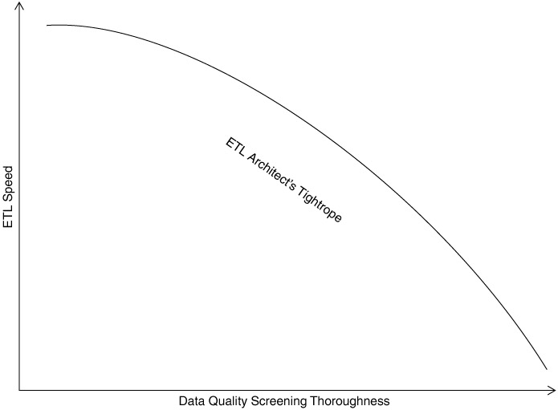

Slide 23
Transformation - Confirming
Structure Enforcement
  Tables have proper primary and foreign keys
  Obey referential integrity
Data and Rule value enforcement
  Simple business rules
  Logical data checks

Slide 24
Stop
Yes
Fatal Errors
Cleaning
And
Confirming
Loading
Staged Data
No

Slide 25
Loading
Loading Dimensions
Loading Facts

Slide 26
Loading Dimensions
Physically built to have the minimal sets of components
The primary key is a single field containing meaningless unique integer – Surrogate Keys
The DW owns these keys and never allows any other entity to assign them
De-normalized flat tables – all attributes in a dimension must take on a single value in the presence of a dimension primary key.
Should possess one or more other fields that compose the natural key of the dimension

Slide 27
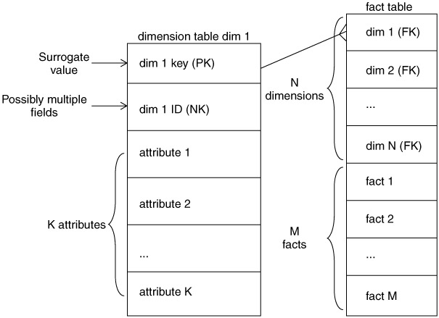

Slide 28
The data loading module consists of all the steps required to administer slowly changing dimensions (SCD) and write the dimension to disk as a physical table in the proper dimensional format with correct primary keys, correct natural keys, and final descriptive attributes.
Creating and assigning the surrogate keys occur in this module.
The table is definitely staged, since it is the object to be loaded into the presentation system of the data warehouse.

Slide 29
Loading dimensions
When DW receives notification that an existing row in dimension has changed it gives out 3 types of responses
  Type 1
  Type 2
  Type 3

Slide 30
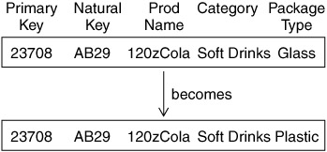
Type 1 Dimension

Slide 31
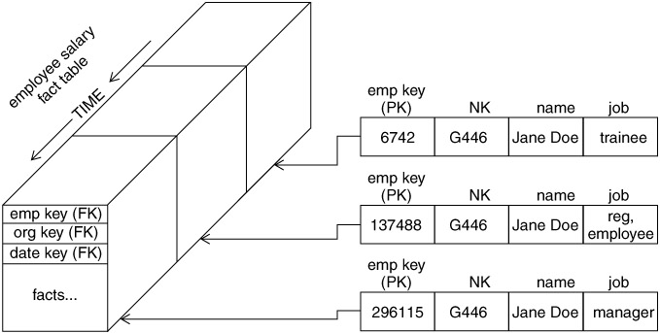
Type 2 Dimension

Slide 32
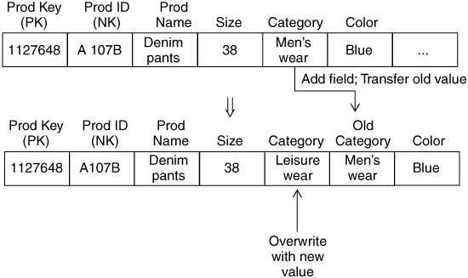
Type 3 Dimensions

Slide 33
Loading facts
Facts
Fact tables hold the measurements of an enterprise. The relationship between fact tables and measurements is extremely simple. If a measurement exists, it can be modeled as a fact table row. If a fact table row exists, it is a measurement

Slide 34
Key Building Process - Facts
When building a fact table, the final ETL step is converting the natural keys in the new input records into the correct, contemporary surrogate keys
ETL maintains a special surrogate key lookup table for each dimension. This table is updated whenever a new dimension entity is created and whenever a Type 2 change occurs on an existing dimension entity
All of the required lookup tables should be pinned in memory so that they can be randomly accessed as each incoming fact record presents its natural keys. This is one of the reasons for making the lookup tables separate from the original data warehouse dimension tables.

Slide 35
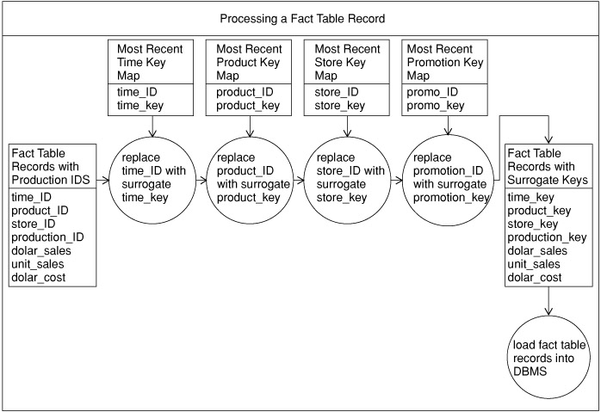
Key Building Process

Slide 37
Loading Fact Tables
Managing Indexes
  Performance Killers at load time
  Drop all indexes in pre-load time
  Segregate Updates from inserts
  Load updates
  Rebuild indexes

Slide 38
Managing Partitions
  Partitions allow a table (and its indexes) to be physically divided into minitables for administrative purposes and to improve query performance
  The most common partitioning strategy on fact tables is to partition the table by the date key. Because the date dimension is preloaded and static, you know exactly what the surrogate keys are
  Need to partition the fact table on the key that joins to the date dimension for the optimizer to recognize the constraint.
  The ETL team must be advised of any table partitions that need to be maintained.

Slide 39
Outwitting the Rollback Log
The rollback log, also known as the redo log, is invaluable in transaction (OLTP) systems. But in a data warehouse environment where all transactions are managed by the ETL process, the rollback log is a superfluous feature that must be dealt with to achieve optimal load performance. Reasons why the data warehouse does not need rollback logging are:
  All data is entered by a managed process—the ETL system.
  Data is loaded in bulk.
  Data can easily be reloaded if a load process fails.
  Each database management system has different logging features and manages its rollback log differently

Slide 40
Questions

